Slide 1



Mini Research about
Data Warehouse Concepts

Slide 2
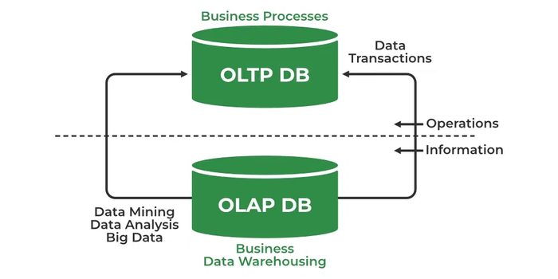
(1) What is OLTP vs. OLAP?
OLTP (Online Transaction Processing):
OLTP is a type of database management that helps manage and process real-time transactions. It is used to handle daily business tasks like processing orders, managing inventory, and doing online banking. OLTP systems deal with high transaction volumes. They make sure the data stays correct and consistent using ACID (Atomicity, Consistency, Isolation, Durability) rules. These systems are designed to handle many short, simple tasks quickly (GeeksForGeeks, 2025, para. 6). Unlike OLAP (Online Analytical Processing), which is focused on analyzing and exploring large datasets, OLTP is primarily concerned with managing daily business transactions (BiSmart, n.d., para. 14).
OLTP Main Features:
Real-time transactions: OLTP manages individual transactions in real-time. It updates data immediately as transactions occur (BiSmart, n.d., para. 15).
Frequent queries and updates: OLTP systems are optimized for frequent read and write operations. They allow multiple users to access and modify data simultaneously (BiSmart, n.d., para. 16).
Database structure: OLTP databases are highly normalized to reduce redundancy and ensure data integrity (BiSmart, n.d., para. 17).
Size of the database: OLTP databases are generally smaller than Data Warehouses used in OLAP (BiSmart, n.d., para. 18).
Focus on availability and integrity: OLTP systems emphasize data availability and integrity. They ensure error-free transactions and consistent data (BiSmart, n.d., para. 19).
OLAP (Online Analytical Processing):
Online Analytical Processing (OLAP) involves tools used to analyze data for business decision-making. OLAP systems enable users to view and extract data from different viewpoints, often in a multidimensional format, which is essential for understanding the complex relationships within the data (GeeksForGeeks, 2025, para. 2). OLAP is designed to analyze and uncover patterns, trends, and connections in data that are stored in a data warehouse or other multidimensional systems (BiSmart, n.d., para. 21).
OLAP Main Features:
Multidimensional data: OLAP organizes data into "OLAP cubes," which contain data in multiple dimensions like time, product, and location. This structure allows users to analyze data from different viewpoints (BiSmart, n.d., para. 22).
Complex analytical operations: OLAP systems support complex operations like drill-down, drill-up, filtering, and rotation, enabling users to explore data at various levels of detail (BiSmart, n.d., para. 23).
Data aggregation: OLAP allows summarizing and aggregating data to gain a broader overview, useful for aggregate analysis such as totals and averages (BiSmart, n.d., para. 24).
Fast response: OLAP systems are designed for quick responses to complex queries using efficient processing and pre-calculation techniques (BiSmart, n.d., para. 25).
Decision support: OLAP helps analyze large business datasets, providing insights that aid in better decision-making (BiSmart, n.d., para. 26).
When to use OLTP vs. OLAP:
OLAP and OLTP serve distinct roles. OLTP handles day-to-day transaction processing and real-time data updates, while OLAP is designed for complex data analysis, reporting, and decision-making. OLTP is optimized for managing high-volume transactions, like banking or order processing, while OLAP is best for tasks requiring large-scale data aggregation, trend analysis, and business intelligence. Choosing between them depends on the business needs, whether you need quick, real-time updates or deep analytical insights. In many cases, businesses use both systems in tandem to balance transactional efficiency with data-driven decision-making (Amazon Web Services, n.d., para. 19).
OLTP Example:
In an ATM, a user must authenticate before withdrawing money WHICH ensurES the requested amount is available. OLTP systems manage transactions like online banking, booking airline tickets, or adding items to an online shopping cart (GeeksForGeeks, 2025, para. 7).
Figure 1
OLTP Example
Note. From GeeksForGeeks, 2025, para. 7.

Slide 3
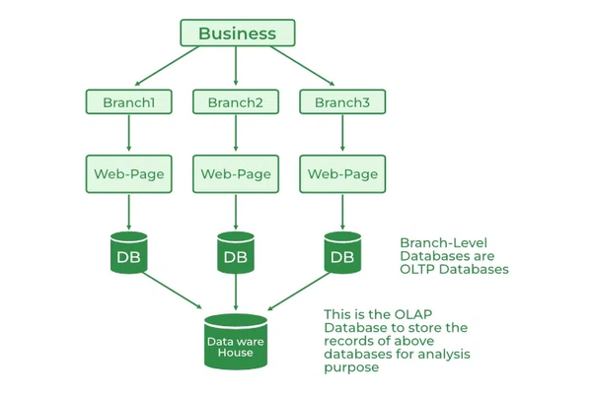
OLAP Example:
Spotify customizes user homepages by suggesting songs and playlists based on their preferences. Netflix uses OLAP to analyze viewing habits and recommend relevant movies or shows (GeeksForGeeks, 2025, para. 3).
Figure 2
OLAP Example
Difference Between OLTP and OLAP:
Note. From GeeksForGeeks, 2025, para. 3.
Table 1
Difference between OLTP and OLAP
Category | OLAP (Online Analytical Processing) | OLTP (Online Transaction Processing)
Definition | Used for analyzing large volumes of historical and aggregated data for decision-making. | Used for managing and processing real-time transactions in business operations.
Data Source | Uses historical data from multiple sources. | Uses real-time transactional data, usually from a single source.
Data Structure | Uses multidimensional structures like OLAP cubes or relational databases. | Uses normalized relational databases.
Data Model | Often uses star or snowflake schema for analytical models. | Uses normalized models (3NF) for data consistency.
Volume of Data | Deals with large amounts of data (TB, PB) and is stored in data warehouses. | Handles smaller amounts of data (GB) for operational tasks.
Response Time | Has longer response times, typically in seconds or minutes. | Has fast response times, typically in milliseconds.
Example Applications | Used for trend analysis, forecasting, and identifying patterns. | Used for tasks like order processing, customer data management, and payment handling.
Task | Provides multi-dimensional analysis and supports decision-making. | Supports day-to-day transactions and operational tasks.
Purpose | Aims to extract insights for planning, problem-solving, and decision-making. | Aims to insert, update, and delete real-time data.
Update Frequency | Data is not updated frequently; updates occur in scheduled batch operations. | Frequent updates occur with user-initiated transactions.
Backup & Recovery | Backups are done periodically. | Regular backups and rigorous recovery procedures are essential.
Query Speed | Queries are slower due to large data volumes and complex analyses. | Queries are fast and operate on a smaller set of data.
Database Design | Focuses on the subject (e.g., business analysis) for multidimensional data. | Focuses on application design to handle transactions and data integrity.
Types of Users | Managed by business analysts, decision-makers like CEOs, and GMs. | Managed by clerks, sales personnel, and other operational staff.
Operations | Primarily read operations with infrequent writes. | Supports both read and write operations.
Nature of Audience | Designed for strategic decision-makers analyzing long-term trends. | Designed for market-facing users focusing on day-to-day operations.
Note. From GeeksForGeeks, 2025, para. 10; Amazon Web Services, n.d., para. 21.

Slide 4
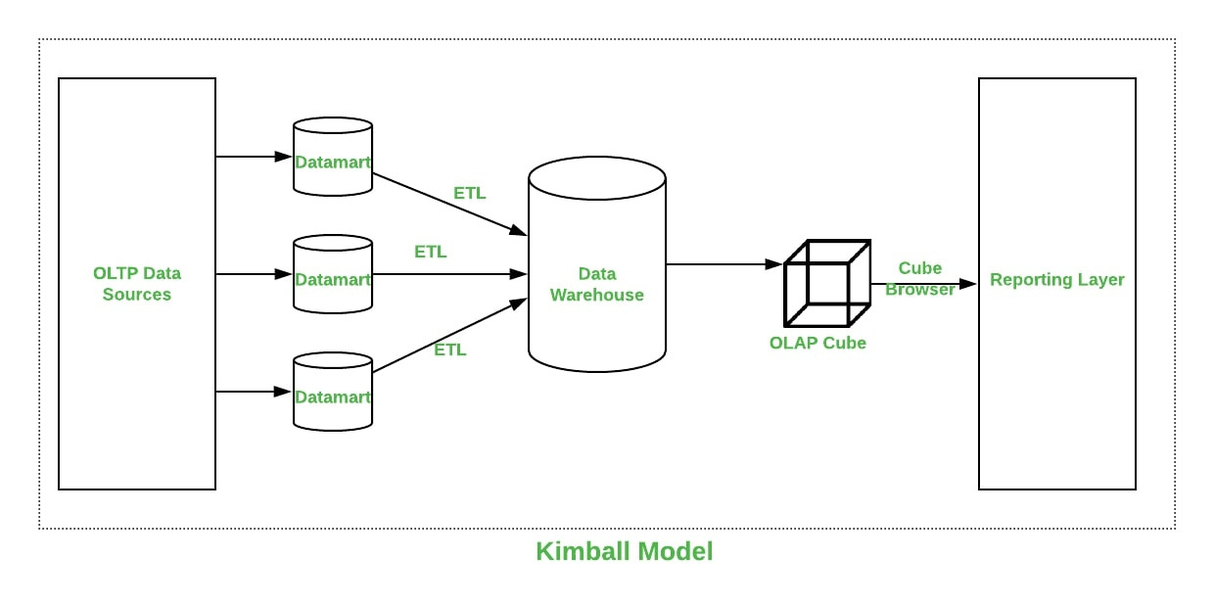
(2) What is the Kimball vs Inmon Dimensional Models?
The Kimball Model:
Ralph Kimball introduced a bottom-up approach to data warehouse architecture, where data marts are created first based on business needs (Naeem, 2024, para. 16). Primary data sources are identified, and an Extract, Transform, and Load (ETL) tool extracts data from multiple sources into a staging area. Once staged, the data is loaded into a dimensional data warehouse, which is denormalized and structured into fact and dimension tables (Naeem, 2024, para. 17).
The star schema is the core of Kimball’s dimensional model, where a fact table links to multiple dimension tables. This structure enables fast query performance for reporting and analytics (Naeem, 2024, para. 19). To ensure consistency, Kimball’s methodology uses conformed dimensions, shared across different fact tables and data marts. It allows uniform data usage across the organization (Naeem, 2024, para. 18).
A key design tool in this approach is the Kimball bus architecture, which uses an enterprise bus matrix to map fact tables and conformed dimensions. This matrix helps organizations prioritize implementation steps (Naeem, 2024, para. 5). Overall, Kimball's approach emphasizes independent data marts that integrate through a well-structured architecture. It ensures flexibility and efficiency in data warehousing (Naeem, 2024, para. 21).
Kimball’s approach to designing a data warehouse involves recognizing the business processes and questions the data warehouse must address. The information is analyzed and documented before ETL software collects data from multiple data sources, called data marts, and loads it into a staging area. The data is then transformed into an OLAP cube for analysis (GeeksForGeeks, 2022, para. 2).
Figure 3
Kimball Model
Note. From GeeksForGeeks, 2022, para. 4
Advantages of the Kimball Model:
Kimball dimensional modeling is quick to build since it avoids normalization, It allows the initial phase of data warehousing design to be completed swiftly (Naeem, 2024, para. 22).
The star schema’s denormalized structure makes it easy for most data operators to understand. It simplifies querying and analysis (Naeem, 2024, para. 23).
The data warehouse has a small footprint as it focuses on specific business areas and processes. It reduces storage requirements and easing system management (Naeem, 2024, para. 24).
Data retrieval is fast since information is organized into fact tables and dimension tables, such as policy and claims transactions in the insurance industry (Naeem, 2024, para. 25).
A smaller team of designers and planners is adequate for managing the data warehouse, as source systems are stable and the warehouse is process-focused. Query optimization is also more straightforward, predictable, and manageable (Naeem, 2024, para. 26).
The conformed dimensional structure ensures data quality and allows business intelligence tools to extract deeper insights from multiple star schemas across the system (Naeem, 2024, para. 27).
Disadvantages of the Kimball Model:
The Kimball approach does not fully integrate data before reporting, which can result in the loss of a "single source of truth." (Naeem, 2024, para. 28).
Irregularities may arise when data is updated in the Kimball data warehouse, as denormalization leads to redundant data being added to database tables (Naeem, 2024, para. 29).
Performance issues may occur in the Kimball data warehouse due to the expansion of the fact table when new columns are added, which can impact its efficiency. Additionally, the dimensional model becomes harder to modify as business needs change (Naeem, 2024, para. 30).
The Kimball model, being process-oriented, focuses on individual business processes rather than the entire enterprise, which limits its ability to handle all business intelligence reporting requirements (Naeem, 2024, para. 31).
Incorporating large volumes of legacy data into the data warehouse is a complex and challenging process (Naeem, 2024, para. 32).

Slide 5
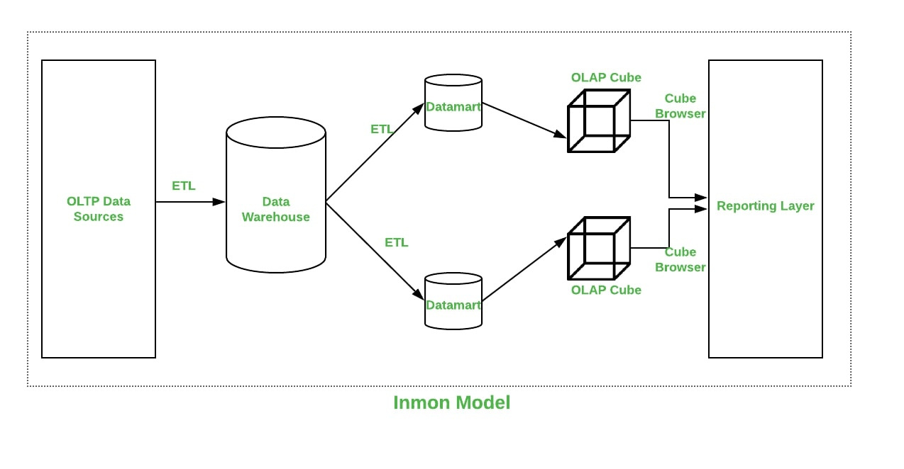
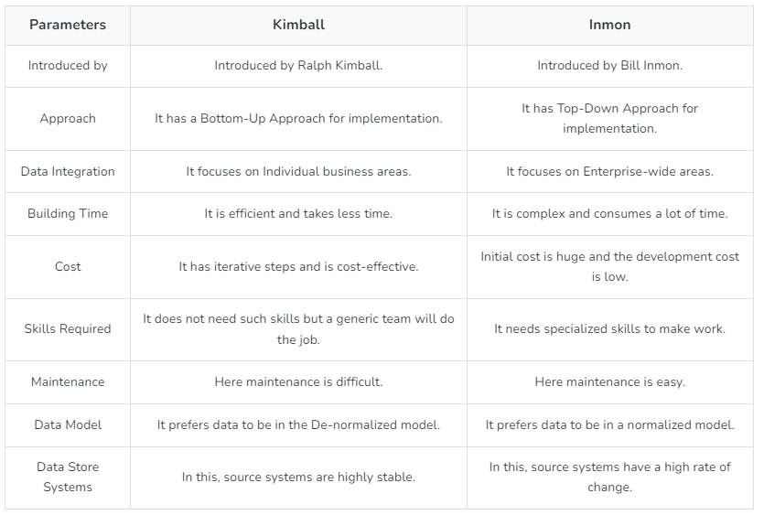
The Inmon Model:
Bill Inmon introduced a top-down approach for designing a data warehouse, beginning with a corporate data model that identifies key business areas like customers, products, and vendors. A detailed logical model is then created for these entities, which leads to the construction of a normalized physical model to minimize data redundancy and ensure consistency across the enterprise (GeeksForGeeks, 2022, para. 5).
The Inmon model employs normalization to avoid data redundancy, ensuring business data integrity and providing a flexible architecture that can adapt to business changes (Naeem, 2024, para. 35).
The physical model, which follows the normalized structure, creates a single source of truth for the entire business, simplifying data loading but making querying more complex due to its multiple tables and links (Naeem, 2024, para. 36).
The Inmon methodology advocates for creating separate data marts for each department, with the data warehouse acting as a unified data source, ensuring consistency and integrity across the organization (Naeem, 2024, para. 37).
Advantages of the Inmon Model:
The Inmon approach provides a centralized data warehouse. It ensures all data is integrated into a single source of truth for the entire organization (Naeem, 2024, para. 38).
Data redundancy is minimized in this model. It reduces the chances of update inconsistencies and streamlining the ETL process which makes it less prone to errors (Naeem, 2024, para. 39).
It simplifies business processes as the logical model offers detailed representations of key business objects (Naeem, 2024, para. 40).
The methodology allows for easier updates to the data warehouse in response to changes in business requirements or source data. That offers greater flexibility (Naeem, 2024, para. 41).
It supports a wide range of enterprise-level reporting requirements. It caters to diverse business needs (Naeem, 2024, para. 42).
Figure 4
Inmon Model
Disadvantages of the Inmon Model:
As the data model evolves over time, complexity increases due to the addition of multiple tables (Naeem, 2024, para. 43).
Finding skilled professionals for data warehouse modeling can be costly and challenging which increases resource requirements (Naeem, 2024, para. 44).
The initial setup and delivery of the model take more time compared to other approaches (Naeem, 2024, para. 45).
An additional ETL process is needed after the creation of the data warehouse to build the data marts (Naeem, 2024, para. 46).
Effective management of the data warehouse requires expert oversight, which can make the approach more resource-intensive (Naeem, 2024, para. 47).
The difference Between Kimball and Inmon Models:
Note. From GeeksForGeeks, 2022, para. 7
Table 2
The difference Between Kimball and Inmon Models
Note. From GeeksForGeeks, 2022, para. 7

Slide 6
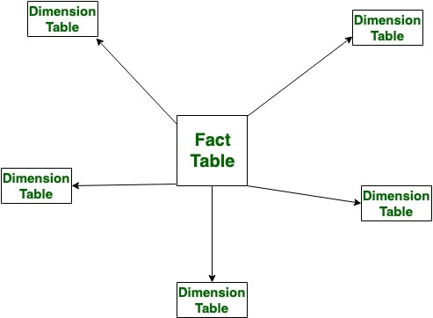
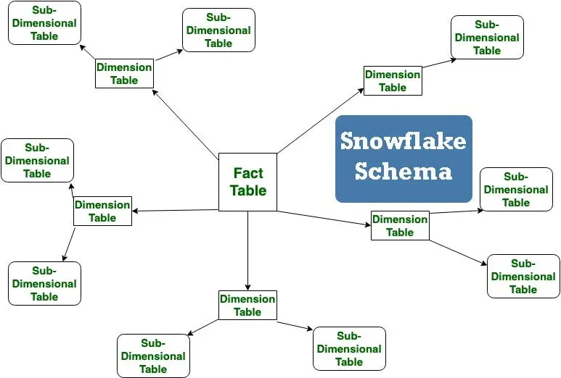
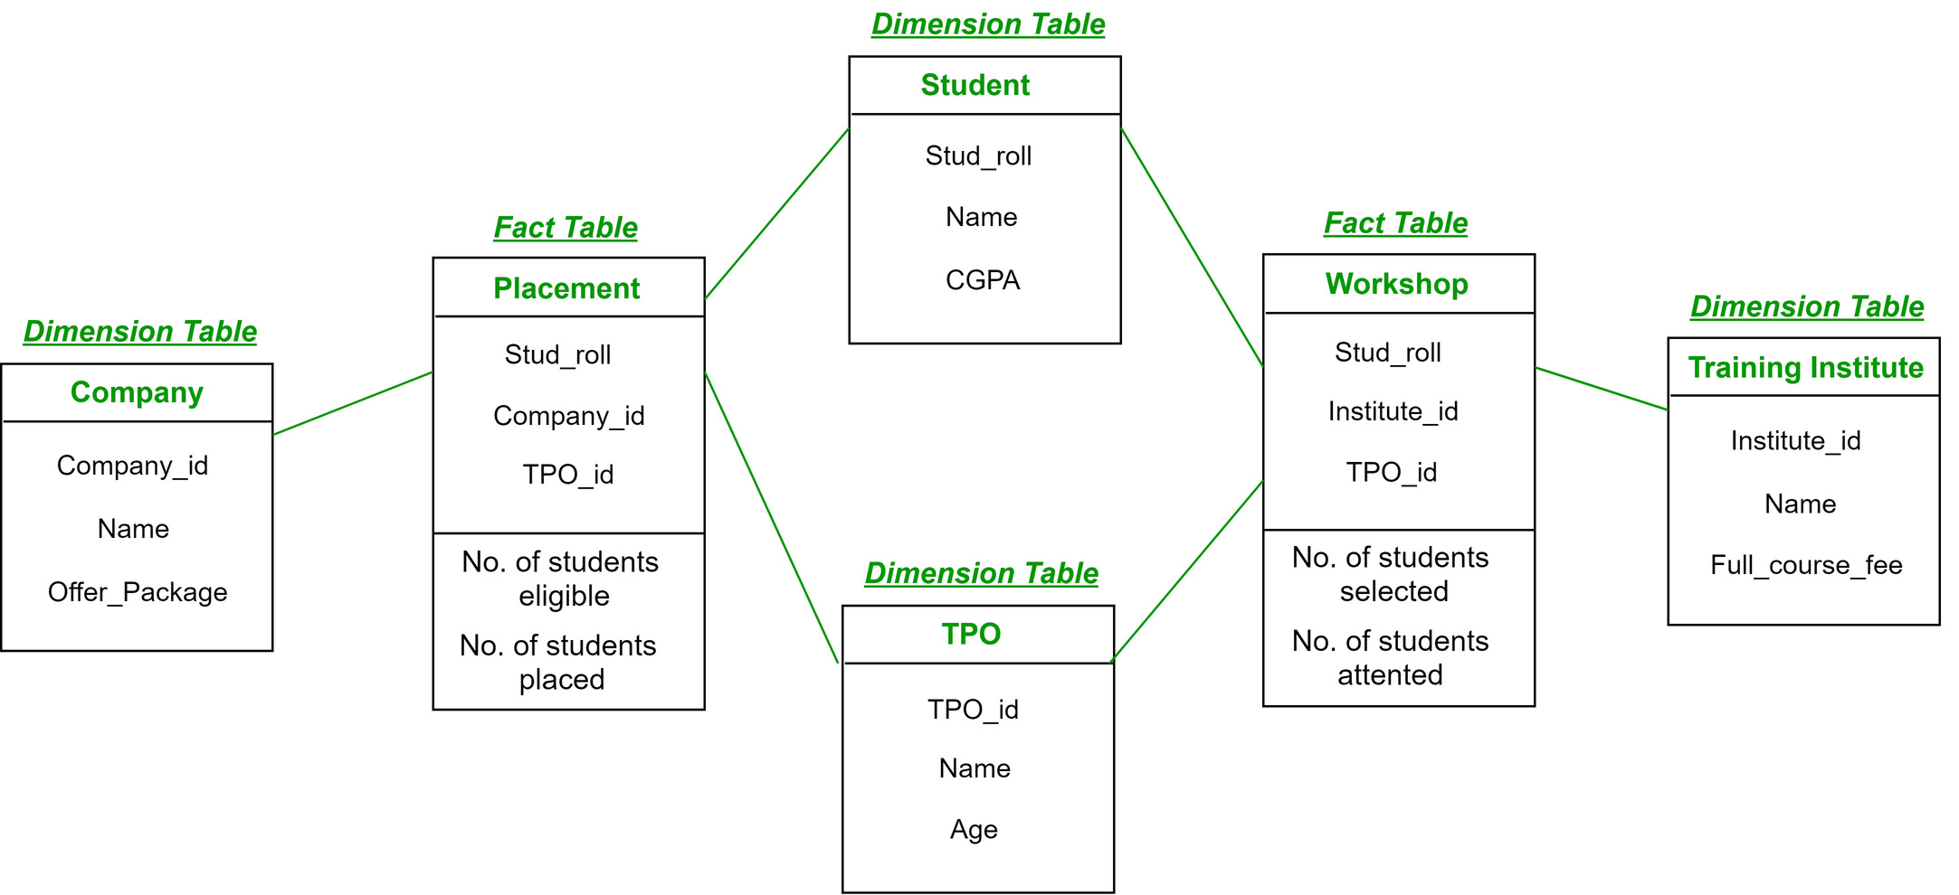
(3) What is the dimension table, and what is the fact table?
Dimension Table:
A dimension table is a type of table in a data warehouse that stores descriptive details about data in a fact table. It helps provide more context to the numbers in fact tables by adding information like names, categories, and other characteristics (Kumar, 2024, para. 19).
Dimension tables usually contain attributes that describe a specific entity, such as a customer, product, or location. These attributes sometimes have a hierarchical structure, meaning they can be grouped into different levels for better analysis. For example, in Airbnb’s data warehouse, dimension tables store information about users, listings, and markets, making it easier to analyze data (Change, n.d., para. 15).
Each row in a dimension table has a primary key, which uniquely identifies it. This key links the dimension table to the fact table. Often, a surrogate key (a system-generated number) is used instead of a natural key because it is simpler and improves query performance (Kumar, 2024, para. 22).
Dimension tables help businesses filter, group, and analyze data effectively. They allow users to break down data into different categories, such as time periods or customer segments. For example, a sales report could show how many customers from a specific region purchased a product in a given year (Sheldon, n.d., para. 4).
Since dimension tables are mostly used for reading data rather than updating it frequently, they are often denormalized. This means the data is stored in a way that makes analysis faster and easier rather than following strict database normalization rules (Sheldon, n.d., para. 10).
Figure 5
Dimension Tables and Fact Table (Star Schema)
Figure 6
Dimension Tables and Fact Table (Snowflake Schema)
Figure 7
Dimension Tables and Fact Tables (Fact Constellation Schema)
Note. From GeeksForGeeks (Fact Constellation in Data Warehouse modelling.), 2025, para. 1
Note. From GeeksForGeeks (Star Schema in Data Warehouse modeling.), 2025, para. 1
Note. From GeeksForGeeks (Snowflake Schema in Data Warehouse Model.), 2025, para. 1
Characteristics of a Dimension Table:
Attribute Relationships: The attributes within a dimension table are typically independent of each other, even though they exist within the same table (Kumar, 2024, para. 23).
Number of Records: Dimension tables generally contain more descriptive attributes than actual records (Kumar, 2024, para. 24).
Primary Key: Each dimension table includes a primary key to uniquely identify individual records (Kumar, 2024, para. 25).
Normalization: These tables are usually denormalized to enhance query performance, as normalization would require multiple joins, slowing down data retrieval (Kumar, 2024, para. 26).
Attributes Expansion: Due to the large number of attributes, dimension tables tend to expand horizontally (Kumar, 2024, para. 27).
Drill-Down and Roll-Up: Attributes within the dimension table allow users to analyze data at different levels, either by drilling down to more detailed information or rolling up to a higher summary level (Kumar, 2024, para. 28).
Attribute Values: Most values in a dimension table are stored as textual descriptions rather than numerical data (Kumar, 2024, para. 29).

Slide 7
Fact Table:
A fact table is a table in a data warehouse that stores numerical values, also called facts or measures, which are related to a business process. It is the center of a dimensional model, surrounded by dimension tables that describe the facts with additional details (Sheldon, n.d., para. 1).
Each fact table has two main types of columns:
Measures – These are numerical values, such as sales amount or total units sold
Foreign Keys – These link the fact table to dimension tables, helping to analyze data from different perspectives (Kumar, 2024, para. 7).
Fact tables are often used to store transactional data, meaning each row represents a specific event, such as a purchase, a booking, or an order. At Airbnb, fact tables track events like reservations, cancellations, and changes (Chang, n.d., para. 13).
A fact table is usually part of a star schema or snowflake schema in a data warehouse. If there are multiple fact tables, they can be connected using a fact constellation schema (Sheldon, n.d., para. 4).
There are three types of fact tables:
Transactional Fact Table – Stores detailed records of business events, like sales transactions (Sheldon, n.d., para. 9).
Snapshot Fact Table – Captures data at specific time intervals, such as monthly sales totals (Sheldon, n.d., para. 10).
Accumulating Fact Table – Tracks a process over time, like an order going through different stages (Sheldon, n.d., para. 11).
Fact tables contain different types of measures:
Additive Measures – Can be summed across any dimension (e.g., total sales) (Sheldon, n.d., para. 13).
Non-Additive Measures – Cannot be summed (e.g., percentage profit) (Sheldon, n.d., para. 14).
Semi-Additive Measures – Can be summed across some dimensions but not others (e.g., daily inventory) (Sheldon, n.d., para. 15).
Some fact tables do not have measures and are called factless fact tables. These tables only store foreign keys but still provide useful insights by linking dimensions together (Sheldon, n.d., para. 16).
Overall, fact tables are essential in a data warehouse because they store key business information and allow organizations to analyze data effectively.
Characteristics of a Fact Table:
Outrigger Dimensions: These are dimensions that reference other dimension tables to enhance the information available in the fact table (Kumar, 2024, para. 11).
Keys: Every fact table has a key composed of primary keys from the associated dimension tables. A concatenated key is one example, serving to uniquely identify each row in the fact table (Kumar, 2024, para. 12).
Additive Measures: Fact tables may contain fully additive measures, which apply to all dimensions. Some measures are only semi-additive, applying to certain dimensions, while others, known as quasi-measures, store only the basic unit of measurement for a business process (Kumar, 2024, para. 13).
Fact Table Grain: The grain defines the level of detail captured in the fact table. The fact table should ideally capture data at the finest level to ensure completeness (Kumar, 2024, para. 14).
Degenerated Dimensions: These are dimensions or attributes included in the fact table but not additive or detailed enough to be treated as dimensions (Kumar, 2024, para. 15).
Sparse Data: In some cases, records in the fact table may include missing values or null data which indicate that certain information is unavailable (Kumar, 2024, para. 16).
Shrunken Rollup Dimensions: These dimensions are derived from the base dimensions by subdividing them into smaller columns and rows. They offer more granular insights (Kumar, 2024, para. 17).
Understanding the Granularity of a Fact Table:
Granularity means the level of detail in a fact table. A fact table with high granularity stores detailed data, like sales at the product, customer, and date level. A fact table with low granularity stores summarized data, like total sales for a product category, region, and month (LinkedIn, n.d., para. 1).
Choosing the right granularity is important because it affects performance and usability. High granularity gives more accuracy and flexibility but requires more storage and processing. Low granularity is simpler and faster but has less detail (LinkedIn, n.d., para. 2).
To decide the right granularity, businesses should consider the questions they want to answer, data availability, and system limitations. The goal is to find a balance between detail and efficiency (LinkedIn, n.d., para. 3).
In a star schema, the fact table’s granularity is set by its lowest level of detail. The dimension tables define hierarchies, allowing data to be grouped at different levels (LinkedIn, n.d., para. 4).
After setting granularity, businesses must test and validate their choice. This can be done using data quality checks, visualization, and performance monitoring to ensure the data meets business needs (LinkedIn, n.d., para. 5).

Slide 8
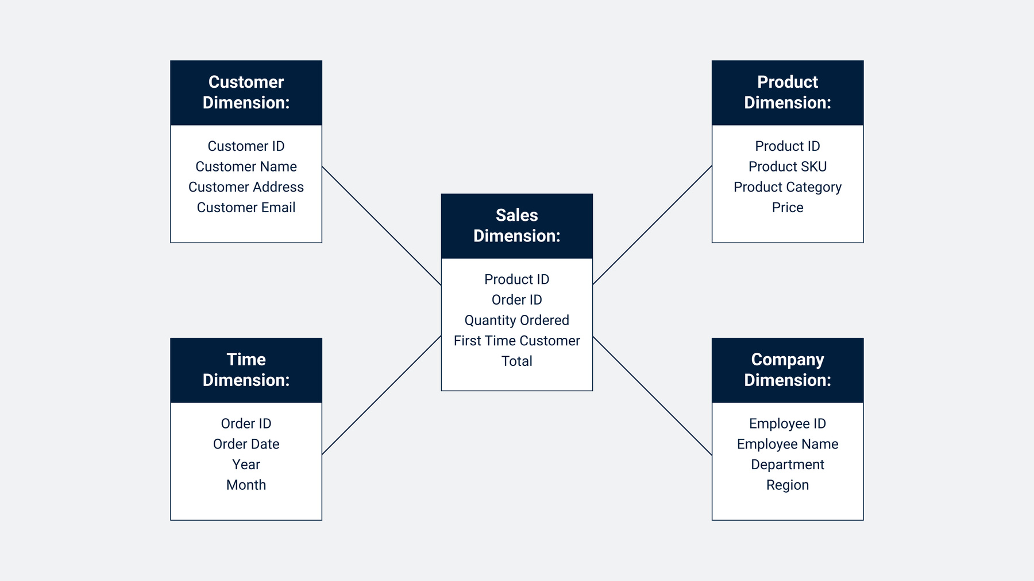
(4) Describe the different type of schemas for Dimensional model?
There are three prominent types of data warehouse schemas: Star Schema, Snowflake Schema, and Fact Constellation Schema. Each schema has its own unique design constraints and represents different organizational structures for data storage and relationships within the data warehouse (Buuck, 2022, para. 8).
Star Schema:
The Star Schema is one of the most straightforward and widely used designs in a data warehouse. It features a central fact table connected to multiple dimension tables. The design is simple and resembles a star, with the central fact table at the center and several dimension tables surrounding it (Buuck, 2022, para. 9).
The Star Schema uses denormalized dimension tables, meaning the dimension tables are structured to introduce redundancy. This design choice aims to improve query performance by minimizing the need for complex joins (Buuck, 2022, para. 10).
Characteristics of the Star Schema:
Denormalized Database Structure: The star schema creates a denormalized database, which is intentionally structured to store redundant data in dimension tables. This approach optimizes query performance by reducing the number of complex joins required when retrieving data (Buuck, 2022, para. 11).
Foreign Key Relationships: Each dimension table in a star schema has a primary key, which is connected to the fact table through a foreign key. This ensures a direct relationship between the fact table and its associated dimensions, simplifying data retrieval and improving performance (Buuck, 2022, para. 12).
Dedicated Dimension Tables: Every dimension in a star schema corresponds to a single, separate dimension table. This structure ensures that all attributes related to a specific dimension are stored within one table that makes it easier to manage and query data efficiently (Buuck, 2022, para. 13).
No Direct Relationships Between Dimension Tables: Dimension tables in a star schema are not directly linked to one another. Instead, all connections occur through the central fact table, preventing complex interdependencies and ensuring a straightforward design that enhances query efficiency (Buuck, 2022, para. 14).
Improved Query Performance Through Denormalization: Since the star schema employs denormalized dimension tables, it enhances query performance by reducing the need for multiple joins. This design choice allows analytical queries to execute more quickly which makes it a preferred schema for data warehousing applications (Buuck, 2022, para. 15).
Figure 8
Star Schema
Note. From Software GmbH, 2022, para. 9
Snowflake Schema:
The Snowflake Schema is a type of data warehouse schema that structures dimension tables in a hierarchical manner. It expands upon the star schema by introducing additional sub-dimension tables, which are connected to the first-order dimension tables that, in turn, are joined to the fact table. This structure further organizes the data by breaking down dimensions into multiple related tables (Buuck, 2022, para. 16).
Similar to the relationship between the foreign key in the fact table and the primary key in the dimension table, the snowflake schema follows the same approach but extends it further. In this schema, the primary key in a sub-dimension table is linked to a foreign key in a higher-order dimension table. It ensures a normalized structure (Buuck, 2022, para. 17).
Snowflake schema employs normalized dimension tables, a database structuring technique that minimizes redundancy by organizing data efficiently. The primary goal of normalization in this schema is to eliminate redundant data, thereby reducing storage overhead and improving data integrity (Buuck, 2022, para. 18).

Slide 9
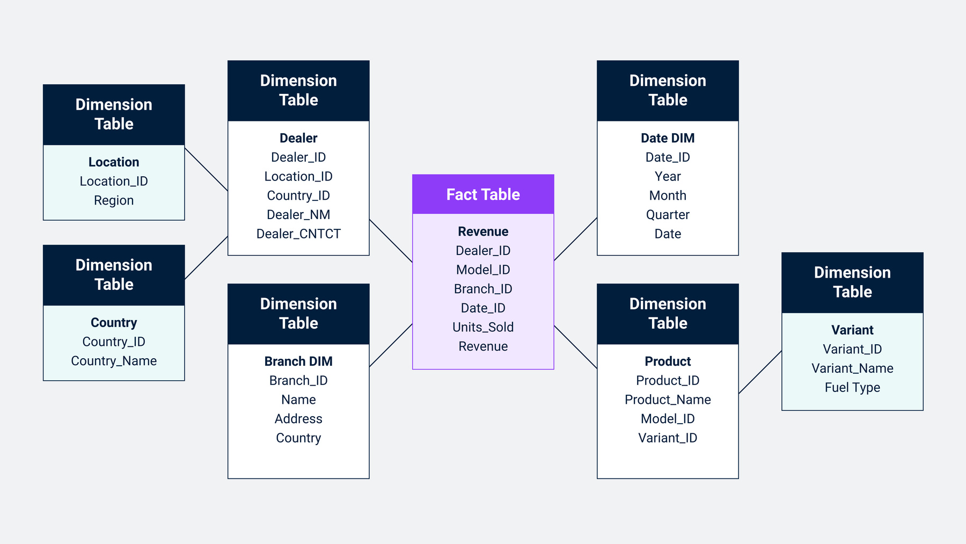
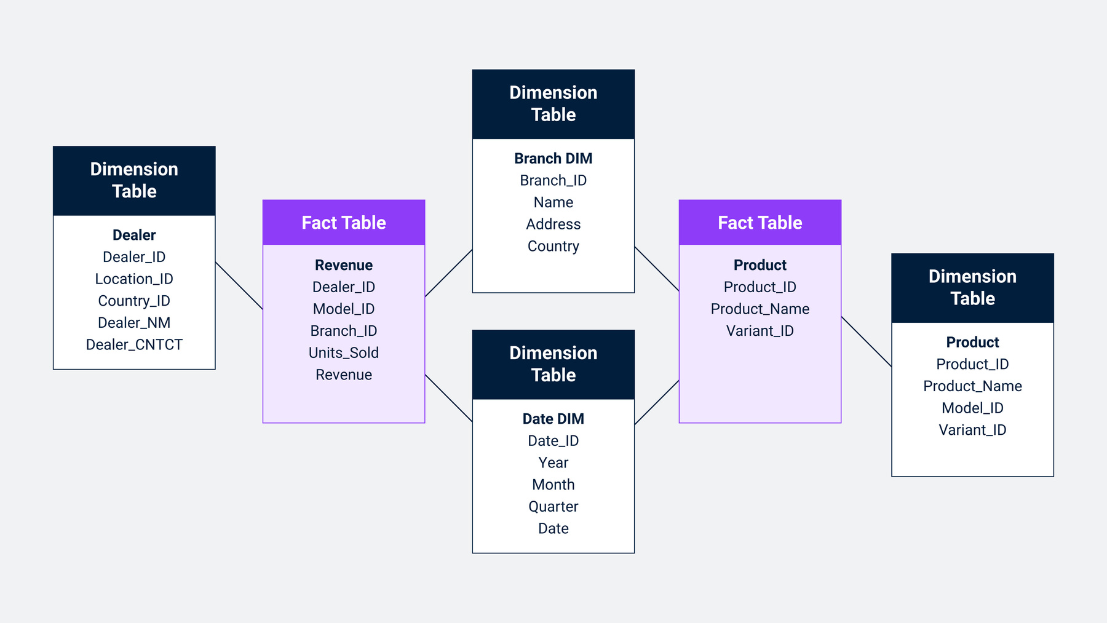
Characteristics of the Snowflake Schema:
In the Snowflake Schema, dimension tables are allowed to be connected to other dimension tables. It creates a hierarchical structure that enables further breakdown of data elements for better organization (Buuck, 2022, para. 19).
The schema is designed to contain only one fact table, which serves as the central repository for numerical measures while all other tables provide contextual information (Buuck, 2022, para. 20).
Snowflake Schema ensures that dimension tables are normalized, meaning that data redundancy is minimized by dividing large tables into smaller, related ones (Buuck, 2022, para. 21).
By normalizing the schema, the required disk space for storing and managing the data warehouse is significantly reduced. It makes it more efficient in terms of storage usage (Buuck, 2022, para. 22).
This schema provides a structured and scalable way to implement dimensions which makes it easier to maintain and manage the relationships between different levels of data (Buuck, 2022, para. 23).
Figure 9
Snowflake Schema
Note. From Software GmbH, 2022, para. 13
The Fact Constellation Schema:
The Fact Constellation Schema, also referred to as the Galaxy Data Warehouse Schema, represents an advanced version of data warehouse schemas. Unlike the Star Schema and Snowflake Schema, the Fact Constellation Schema is designed to support complex analytical processing by utilizing multiple fact tables that share normalized dimension tables. This structure allows different business processes to be represented within the same schema while ensuring data integrity and consistency. The Fact Constellation Schema can be visualized as multiple star schemas interconnected, where each fact table links to shared dimensions which creates a well-structured and normalized data model. By eliminating redundancy and preventing data inconsistencies, this schema enhances efficiency and accuracy in large-scale data warehousing systems (Buuck, 2022, para. 24).
Characteristics of the Fact Constellation Schema:
The Fact Constellation Schema is multidimensional which makes it a strong design choice for handling complex database systems where multiple business processes need to be analyzed simultaneously (Buuck, 2022, para. 25).
Through normalization, this schema effectively eliminates redundancy. That ensures that duplicate data is minimized or nearly eliminated, which helps maintain data integrity and optimize storage usage (Buuck, 2022, para. 26).
This schema is recognized for maintaining high data quality and accuracy, which makes it a preferred choice for organizations that rely on effective reporting and analytics to gain meaningful insights from their data (Buuck, 2022, para. 27).
Figure 10
Fact Constellation Schema
Note. From Software GmbH, 2022, para. 15

Slide 10
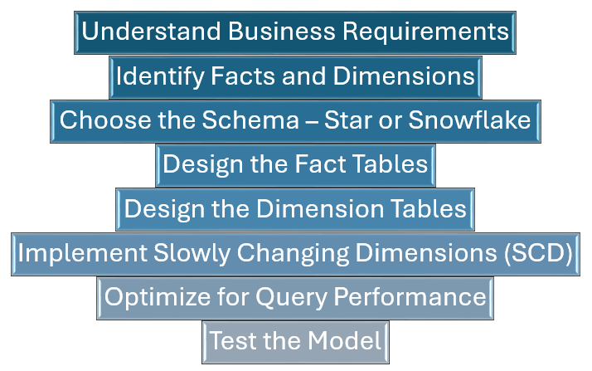
(5) Based on your readings, list the key steps to create a new dimensional model?
To build a dimensional data model, a structured methodology is followed to ensure the proper design of the database. This approach follows a top-down methodology, starting with identifying the primary business processes where data is collected. The database designer must analyze the existing data sources to create fact tables that accurately represent business operations. A dimensional database can be based on multiple business processes and contain many fact tables (IBM, 2021, para 1). Below are the key steps involved in constructing a dimensional data model:
Figure 11
Key steps involved in constructing a dimensional data model
Note. Created by Khalas, PowerPoint Presentation, n.d.

Slide 11
Key Steps to Create a Dimensional Model:
Understand Business Requirements:
The first step in creating a dimensional model is to thoroughly understand the business requirements. This includes gathering information from stakeholders, such as business analysts and end-users, to understand the business processes, the metrics they need to track, and the type of analysis they want to perform. It’s crucial to know the kind of reports that will be generated, the level of detail required, and how the data will be queried. By understanding these needs, you can design a model that effectively meets business goals (Bhuyan, 2024, para. 3).
Identify Facts and Dimensions:
Once the business requirements are clear, the next step is to identify the facts and dimensions. Fact tables store quantitative data, like sales numbers, revenue, or profit margins, which are used for analysis. These are the key metrics of the business process. Dimension tables, on the other hand, store descriptive data that provides context to the facts, like time, product, customer, or location. By connecting facts with dimensions, you can make the data more meaningful and enable deeper analysis (Bhuyan, 2024, para. 4).
Choose the Schema – Star or Snowflake:
In dimensional modeling, you need to decide on the schema design, typically choosing between Star Schema and Snowflake Schema.
Star Schema: In this design, the fact table is at the center and directly connected to dimension tables. It’s simple, fast, and easy to understand, making it suitable for straightforward reporting and analysis.
Snowflake Schema: This design normalizes the dimension tables, breaking them into smaller related tables to eliminate redundancy. While this saves storage space, it can lead to more complex queries due to the need for multiple joins (Bhuyan, 2024, para. 5). The choice between these schemas depends on the complexity of the data and performance needs.
Design the Fact Tables:
Designing the fact table is crucial as it holds the core data for analysis. The fact table should include the key measures (like sales, revenue, or quantities) and foreign keys that link to dimension tables. The granularity of the fact table should also be carefully chosen—this refers to the level of detail at which the data is recorded. For example, data can be stored at a transaction level, daily, or monthly level, depending on the business need. The level of granularity impacts both the amount of data stored and query performance (Bhuyan, 2024, para. 6).
Design the Dimension Tables:
Dimension tables are critical for providing context to the data. These tables should contain descriptive attributes related to the business entities. For example, a time dimension table might include attributes like day, month, quarter, and year, while a product dimension could include attributes like product name, category, and manufacturer. Organizing the attributes in hierarchies allows users to drill down into the data at different levels (e.g., from year → quarter → month → day). Each dimension table should have a unique primary key, which will be used as foreign keys in the fact table to establish relationships (Bhuyan, 2024, para. 7).
Implement Slowly Changing Dimensions (SCD):
Dimensions may change over time—for example, a customer’s address or a product’s category. Slowly Changing Dimensions (SCD) is a technique to track these changes.
Type 1: Overwrites old data with new data. This is suitable when the changes are not important for historical analysis.
Type 2: Creates a new record for each change and tracks the history, preserving past information.
Type 3: Adds new fields to store both old and new values, used for tracking limited history (Bhuyan, 2024, para. 8). The type of SCD implemented depends on the business need and how much historical data is important to keep.
Optimize for Query Performance:
Optimizing the dimensional model for query performance is essential to ensure that queries are executed quickly, especially as the volume of data grows. Some common optimization techniques include indexing tables, using materialized views to pre-aggregate data, and denormalizing dimension tables to reduce the number of joins required. By making these changes, you can improve query performance, ensuring that users can quickly get the insights they need (Bhuyan, 2024, para. 9).
Test the Model:
Before deploying the dimensional model into production, thorough testing is required to ensure its correctness and efficiency. Data quality checks should be performed to validate the data in the fact and dimension tables, ensuring it is accurate, complete, and consistent. Additionally, the model should be tested for performance, ensuring that it can handle large datasets and execute queries in a reasonable amount of time. User acceptance testing (UAT) is crucial at this stage, as it ensures that end-users can access the data and generate valuable insights from it (Bhuyan, 2024, para. 10).
By following these key steps, organizations can design a robust and effective dimensional model that supports business intelligence, reporting, and analytics needs, enabling users to make data-driven decisions.

Slide 12
References
Amazon Web Services. (n.d.). What’s the Difference Between OLAP and OLTP?
https://aws.amazon.com/compare/the-difference-between-olap-and-oltp/
Bhuyan, A. (2024, December 11). Key Steps to Create a Dimensional Model for a Database. Dev Community.
https://dev.to/adityabhuyan/key-steps-to-create-a-dimensional-model-for-a-database-3eh8
BiSmart. (n.d.). Data Warehousing: ETL, OLAP and OLTP.
https://blog.bismart.com/en/data-warehousing-olap-oltp#:~:text=OLTP%20is%20used%20to%20manage%20day%2Dto%2Dday%20business%20operations,information%20for%20business%20decision%20making.
Buuck, B. (2022, May 29). Schemas used in data warehouses: Star, Galaxy, and Snowflake. Software GmbH.
https://www.softwareag.com/en_corporate/blog/streamsets/schemas-data-warehouses-star-galaxy-snowflake.html
Chang, R. (n.d.). A Beginner’s Guide to Data Engineering – Part II. KDNuggets.
https://www.kdnuggets.com/2018/03/beginners-guide-data-engineering-part-2.html
GeeksForGeeks. (2025, January 28). Difference Between OLAP and OLTP in Databases.
https://www.geeksforgeeks.org/difference-between-olap-and-oltp-in-dbms/
GeeksForGeeks. (2025, February 12). Snowflake Schema in Data Warehouse Model.
https://www.geeksforgeeks.org/snowflake-schema-in-data-warehouse-model/
GeeksForGeeks. (2025, February 12). Star Schema in Data Warehouse modeling.
https://www.geeksforgeeks.org/star-schema-in-data-warehouse-modeling/
GeeksForGeeks. (2022, August 02). Difference between Kimball and Inmon.
https://www.geeksforgeeks.org/difference-between-kimball-and-inmon/
GeeksForGeeks. (2019, August 19). Fact Constellation in Data Warehouse modelling.
https://www.geeksforgeeks.org/fact-constellation-in-data-warehouse-modelling/
IBM. (2021, March 03). Building a dimensional data model.
https://www.ibm.com/docs/en/informix-servers/12.10?topic=model-building-dimensional-data
Kumar, A. (2024, October 17). Fact Table vs. Dimension Table - Differences Between The Two. SimpliLearn.
https://www.simplilearn.com/fact-table-vs-dimension-table-article
LinkedIn. (n.d.). How do you choose the right level of granularity for your fact tables and dimensions?
https://www.linkedin.com/advice/0/how-do-you-choose-right-level-granularity-your
Naeem, T. (2024, September 03). Data Warehouse Concepts: Kimball vs. Inmon Approach. Astera.
https://www.astera.com/type/blog/data-warehouse-concepts/
Sheldon, R. (n.d.). Dimension Table. Informa.
https://www.techtarget.com/searchdatamanagement/definition/dimension-table#:~:text=What%20is%20a%20dimension%20table,defined%20in%20a%20dimensional%20model.

